Slide 1
SMARTGUARDIAN
To overcome your fear of swimming

Slide 2
GROUP
Supervisor Dr. Pradeep Abeygunawardhana
Group members
K.D.Samarasinghe IT16059214 ( Leader )
P.M.De Silva IT16041080
T.U Mudalige IT16102842
Gamage M.K.I IT16105812

Slide 3
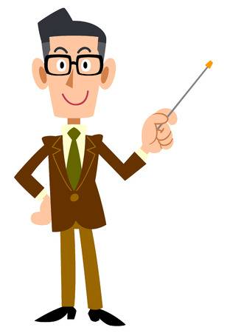
EXPLAIN ABOUT
”The worst thing is watching someone drown and not being able to rescue”
Drowning is the second leading cause of accidental deaths in the world, next to road accidents.
Negligence is the most of the time root cause for drowning.
Floods are common natural disasters that cause severe devastation of any country
Overflowing lake, river

Slide 4
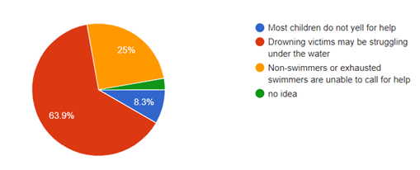
WHY PEOPLE CANNOT SHOUT FOR HELP?
Figure 1. why people cannot shout for help?

Slide 5
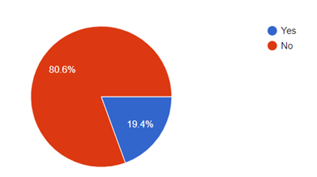
WOULD YOU GET INTO THE WATER WITHOUT KNOWING THE DEPTH?
Figure 2. Would you get into the water without knowing the depth of the water

Slide 6
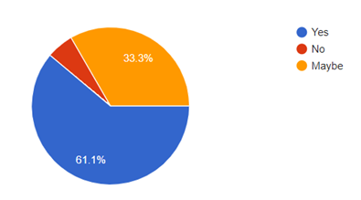
DO YOU THINK FLOOD PREDICTION IS HELPFUL TO YOURSELF?
Figure 3. Do you think flood prediction is helpful to yourself?

Slide 7
Closest Attempt
iSwimBand (iswimband.com)
Founded in 2013 by Paul Chu.
Only for children.
Uses RF Transmission for Communication.
Alerts to the app if child get drowned.

Slide 8
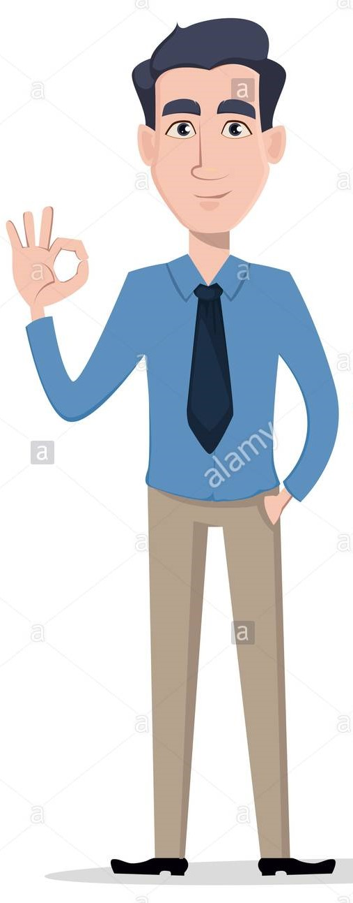
PRODUCT EXPLANATION
What is consist,
Wearable device
Predict condition
Measure depth
Floating device
Detect the flood
Detect the user and floating device location
Cloud server
Include algorithms and data
Connecting floating devices
Security mechanism

Slide 9

PROBLEMS
Main 4 research problems,
How to identify whether related person is in critical condition?
How to do the underwater communication?
How to locate the affected person ?
How to predict the flood and identify the flood area?

Slide 10
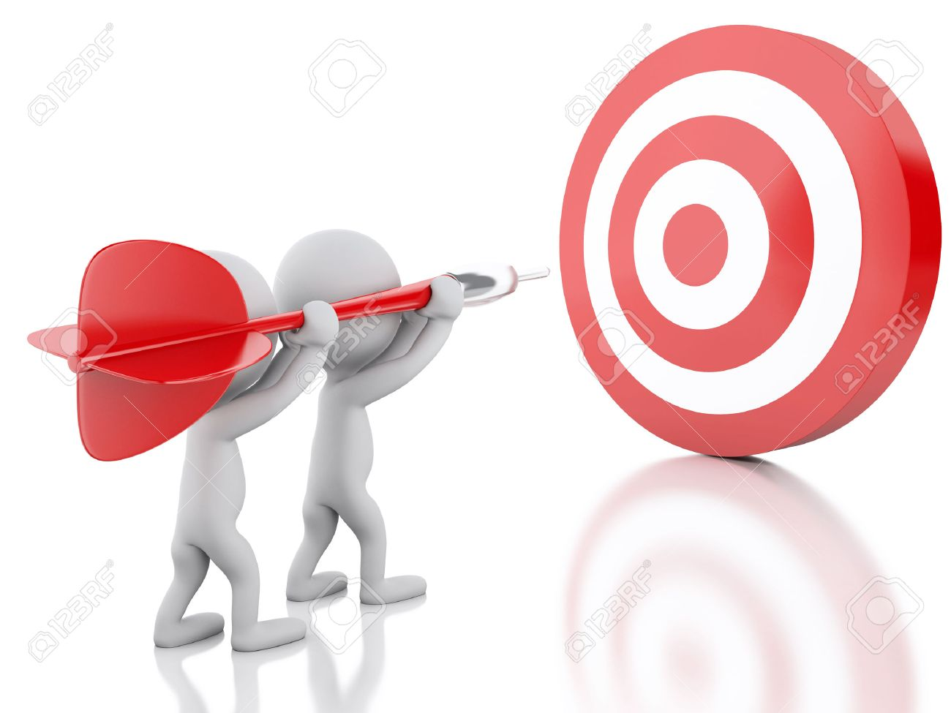
OBJECTIVES
The main objective is introducing a full featured smart guardian system comprise with two devices
Identify the user condition and depth of water
Transmit the data through underwater communication to the respective floating device.
Identify the location of floating devices and affected user
Predict the flood
Enhance security mechanism

Slide 11
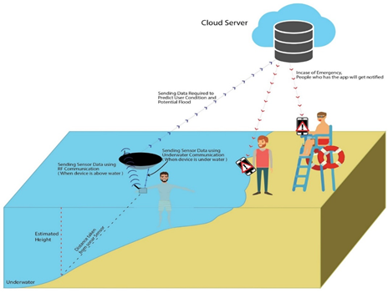
OUR PRODUCT DESIGN
Figure 4. product flow

Slide 12
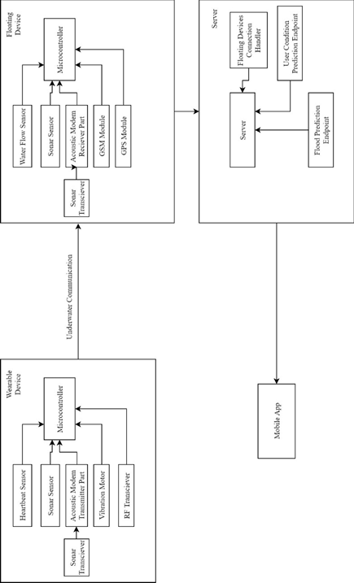
HIGH LEVEL ARCHITECTURE DIAGRAM
Figure 5. High level architecture diagram

Slide 13
1. DESIGN AND DEVELOPMENT OF WEARABLE DEVICE FOR USERS WITH PARTICULAR SENSORS & DETECT USER CONDITION
K.D.SAMARASINGHE IT16059214

Slide 14
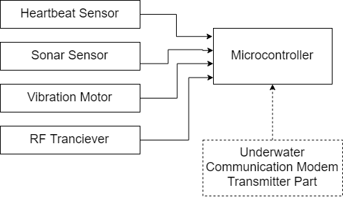
1.1 DESIGN AND DEVELOPMENT OF WEARABLE DEVICE
Waterproof .
Will be worn on Wrist.
Based on Arduino UNO Microcontroller.
Two Main Functions
Estimating the depth of water and alert if user is going to deeper area
Monitor user’s pulse rate to predict user condition .
( Underwater Communication modem’s transmitter part is also integrated in wearable device . will be discussed on next subtopic )

Slide 15
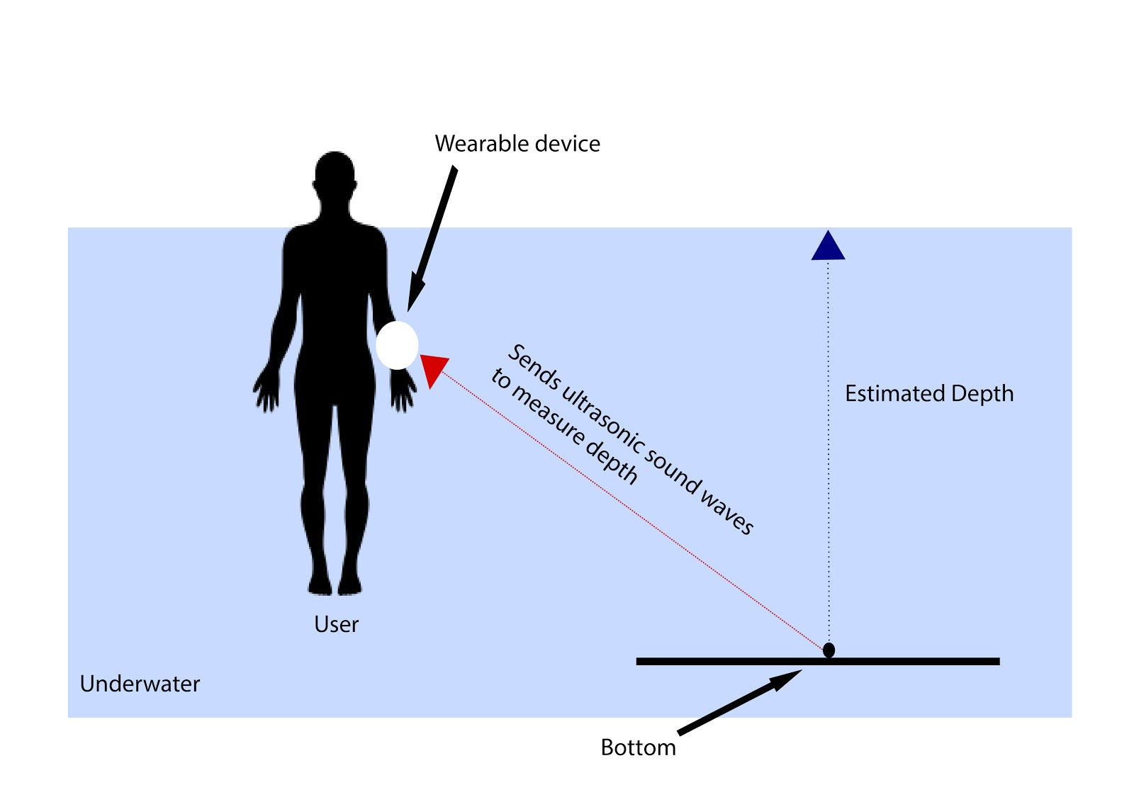
ESTIMATING THE DEPTH OF WATER
Figure 5: structure of estimating the depth

Slide 16
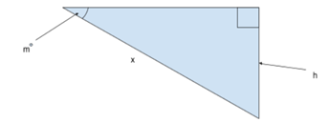
1.1.1 ESTIMATING THE DEPTH OF WATER
Sonar sensor will be used to get the Distance ( x )
Gyro and Accelerometer Sensor will be used to get the Degree of angle ( m )
Estimated height ( h ) will be achieved through trigonometry theorems
Figure 6: trigonometry
Sin(m) = h/x
Hence,
h = x.Sin(m)

Slide 17

1.1.2 DETECT THE USER CONDITION
Pulse is collected from user and it will be transmitted to the server .
Uses Machine Learning to predict the user condition .

Slide 18
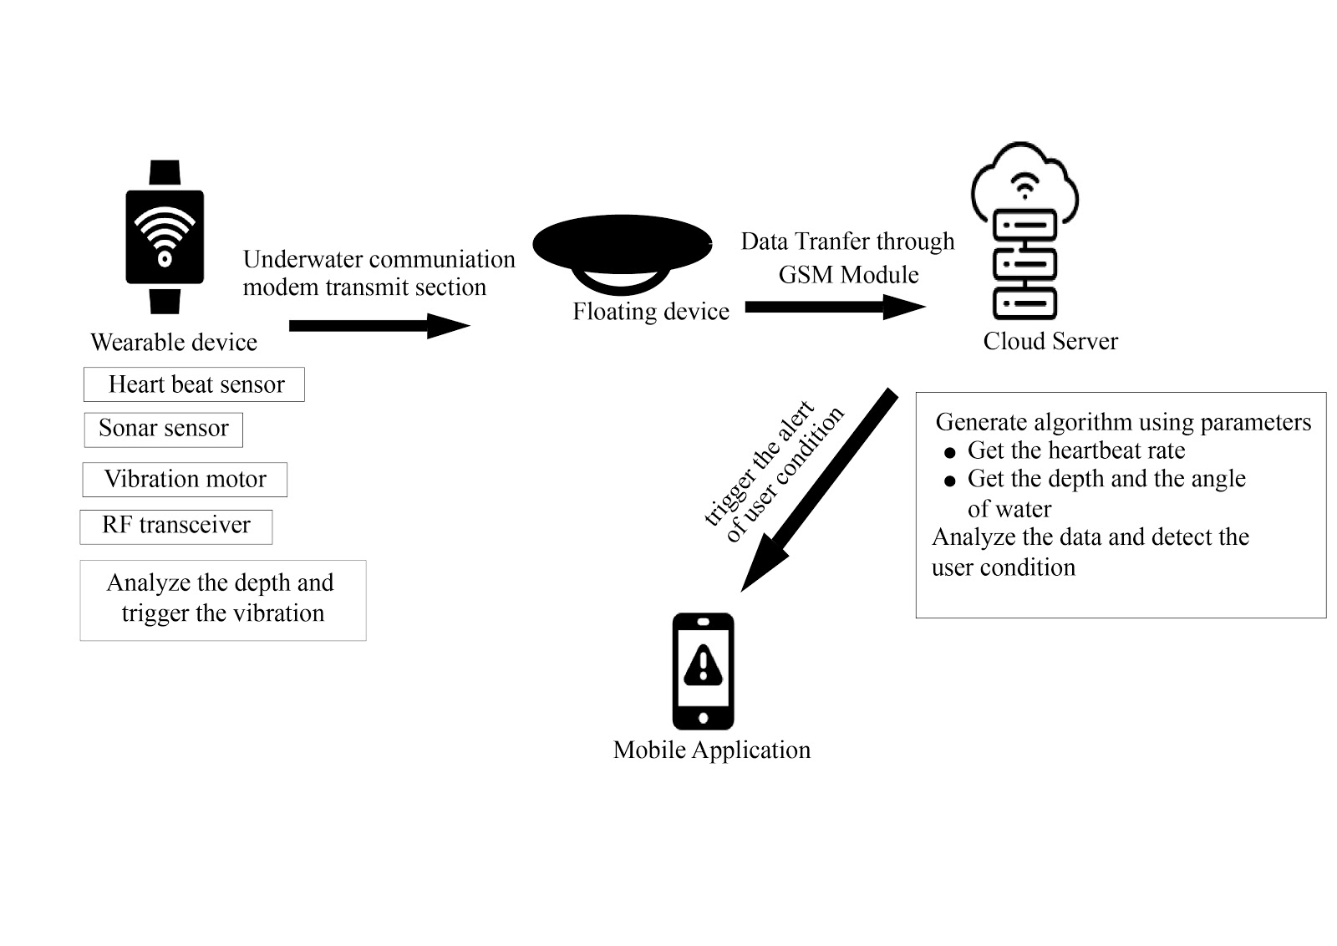
ARCHITECTURE DIAGRAM OF WEARABLE DEVICE
Figure 07. architecture diagram of wearable device

Slide 19
2 UNDERWATER COMMUNICATION IN BETWEEN WEARABLE AND FLOATING DEVICES
GAMAGE M.K.I IT16105812

Slide 20
Technique of sending and receiving message below water.
A hardware implementation of an Acoustic Modem
ASK modulation/demodulation
Underwater communication software : packet formatting
Error control schemes
Automatic Repeat Request (ARQ) : Sender corrects errors with retransmission
Cyclic Redundancy Check (CRC)
Acknowledgment (ACK) : short message sent by the receiver
Negative Acknowledgement (NACK) : Sent by the receiver

Slide 21
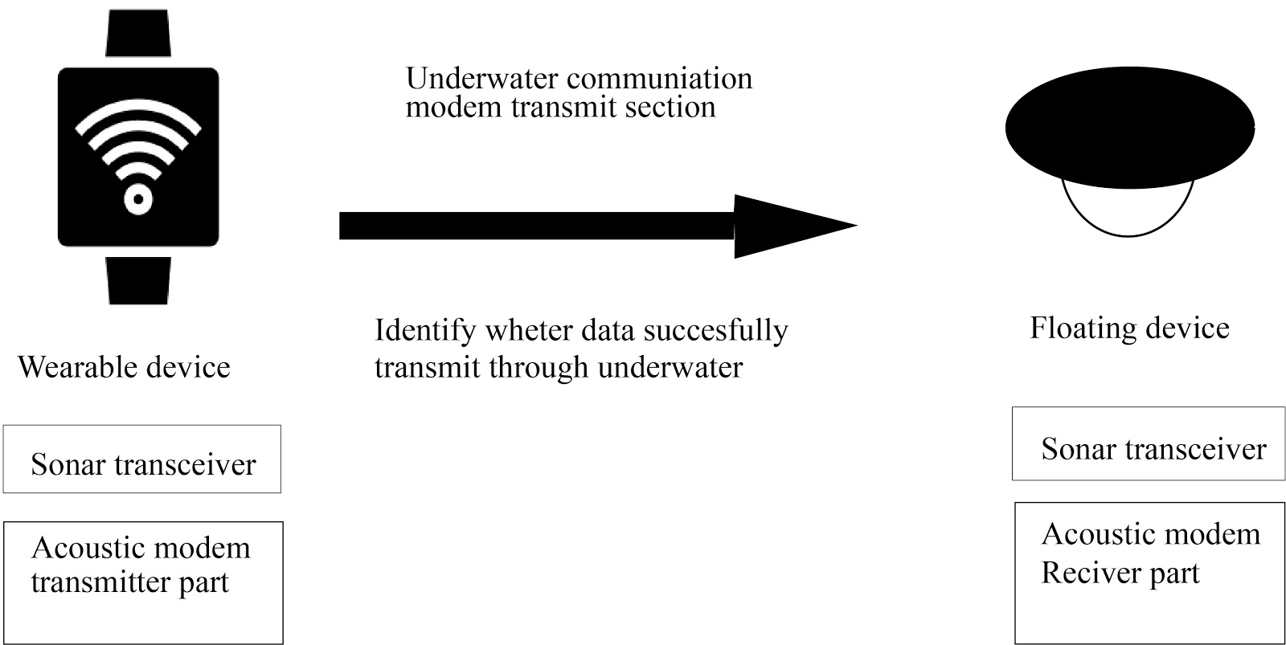
ARCHITECTURE DIAGRAM OF UNDERWATER COMMUNICATION
Figure 8 Architecture diagram of underwater communication

Slide 22
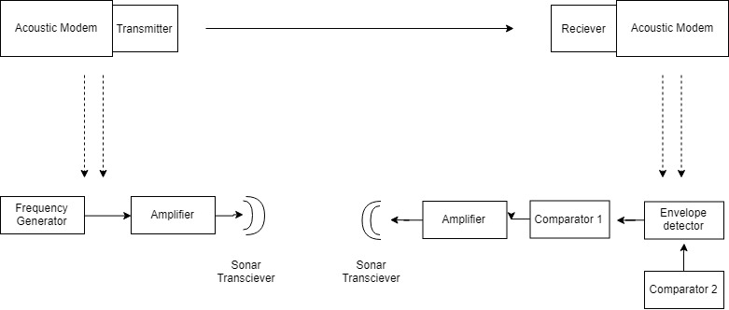
HARDWARE IMPLEMENTATION OF AN ACOUSTIC MODEM
Figure 9 Hardware implementation of an acoustic modem

Slide 23
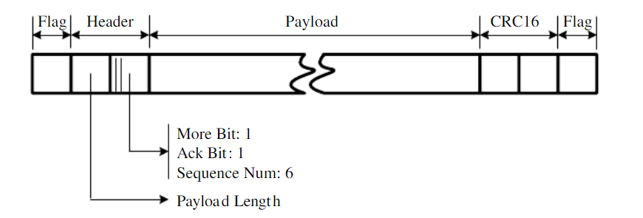
2.1 UNDERWATER COMMUNICATION SOFTWARE : PACKET FORMATTING
Figure 10 packet formatting
Flag : The ﬂag uses a bit sequence of 11011011
Payload length : 1 byte
More bit : 1 bit
Ack bit : 1 bit
Sequence number bit (SNB) : 6 bits

Slide 24
3 CREATING A FLOATING DEVICE AS AN INTERMEDIARY SOURCE FOR WATER COMMUNICATION WITH THE SERVER
P.M.DE SILVA IT16041080

Slide 25
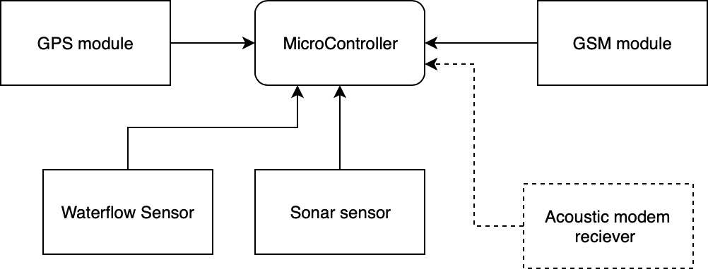
3.1 DESIGN AND DEVELOPMENT OF FLOATING DEVICE
Main component is placed on Arduino uno microcontroller
Fundamental part of floating device is to send gathered data to the server.
This includes all the data that it receives from the wearable device and all the data that is gathered by the floating device component itself
Calculate the depth of the water using sonar sensor

Slide 26
3.2 SENDING DATA TO THE SERVER
The floating device will receive all the data that the wearable device sends and combines that data with all the sensor readings that are on the wearable device itself
Using the GSM module component that's attached to the floating device, the data will be sent to the server for further analyzations.

Slide 27
3.3 LOCATING A WEARABLE DEVICE
Data sent time and data receive time will be compared
distance = time * speed
location radius will be shown on a map

Slide 28
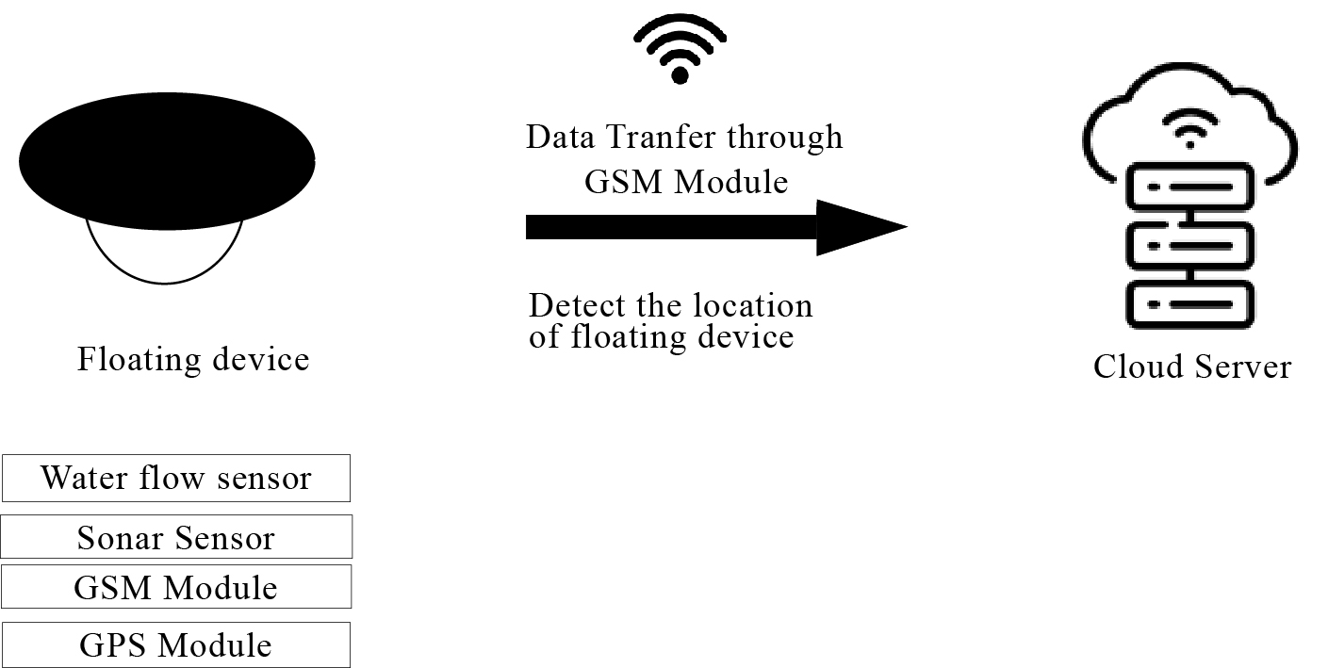
ARCHITECTURE DIAGRAM OF FLOATING DEVICE
Figure 11 Architecture diagram of floating device

Slide 29
4. PREDICT THE FLOOD AND ENHANCE THE SECURITY OF FLOATING DEVICES
T.U MUDALIGE IT16102842

Slide 30
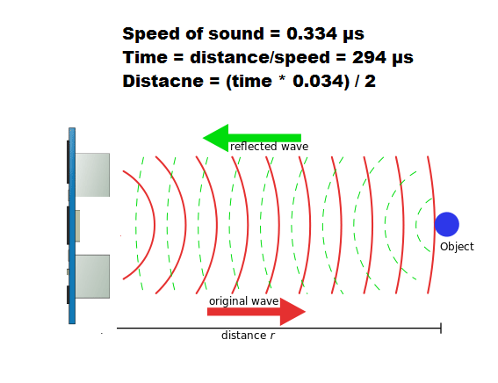
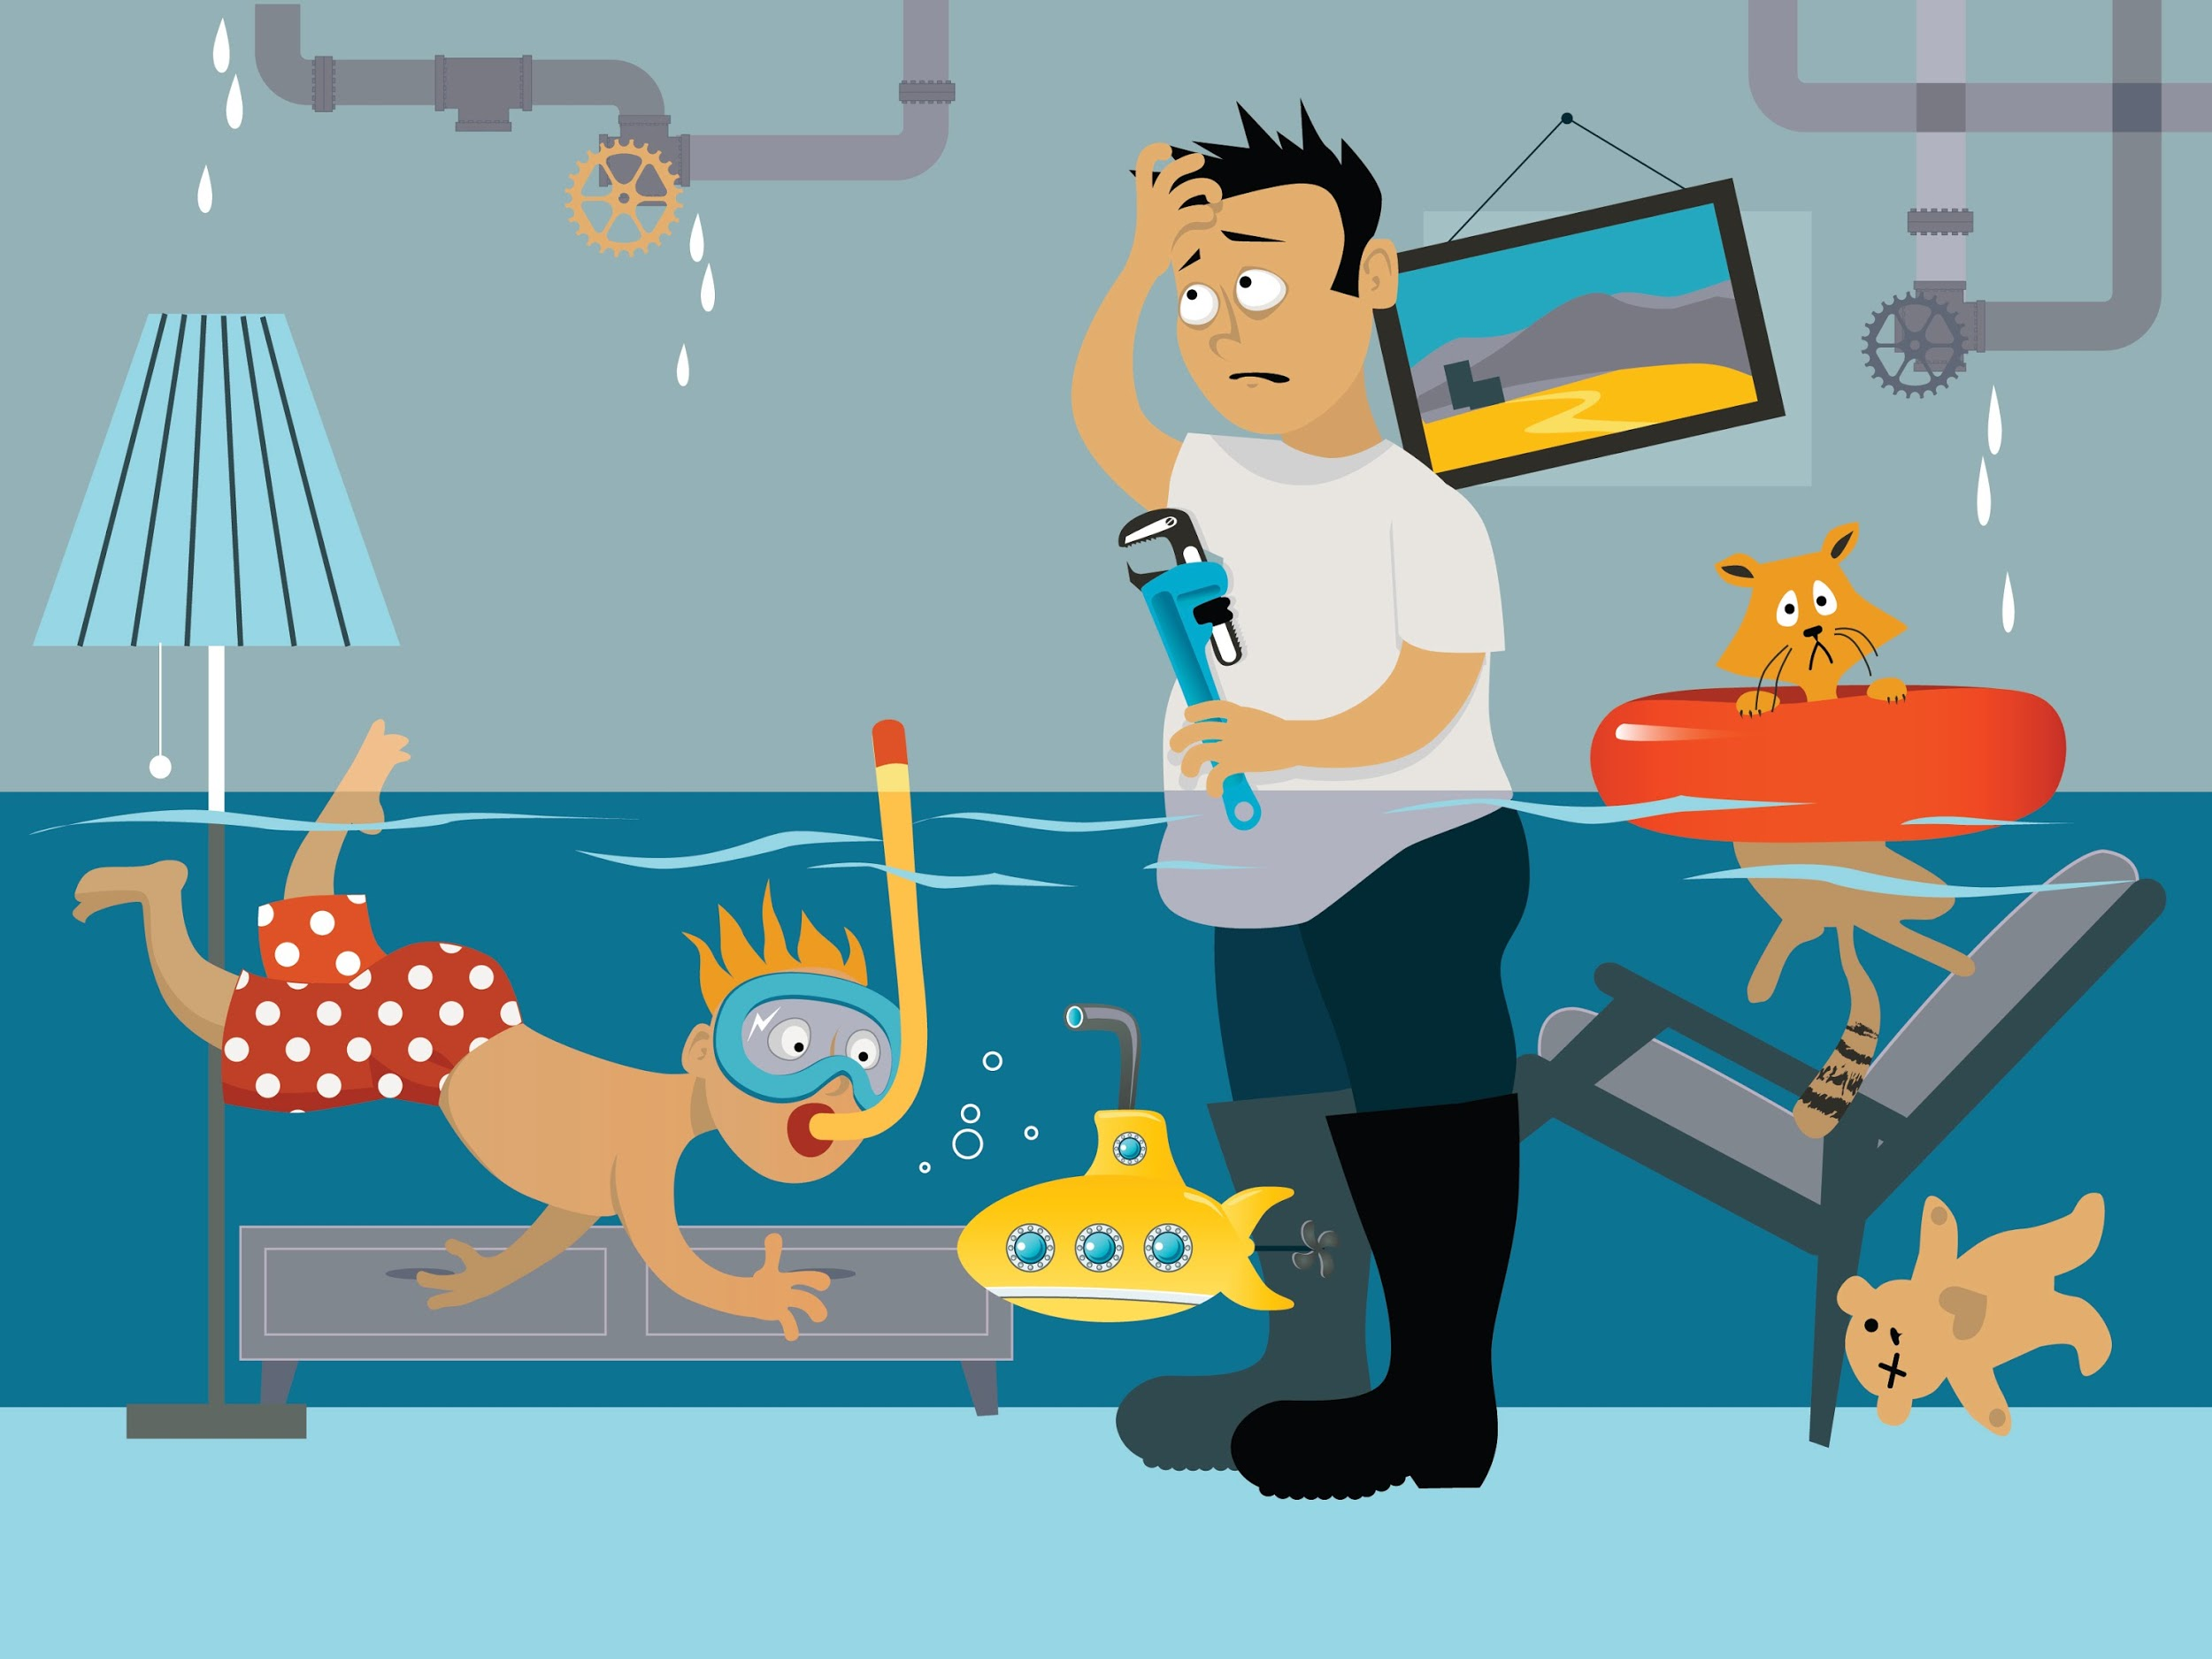
4.1 FLOOD DETECTION
Create a new algorithm using below parameters
Flow rate : water flow sensor
Flow rate = (flow frequency*60)/7.5 ; (liters per hour)
Depth of the water : ultrasonic sonar sensor
distance= speed of sound * (travel time/2) ; (meter)
Location : GPS module
Notify the user about flood through mobile application

Slide 31
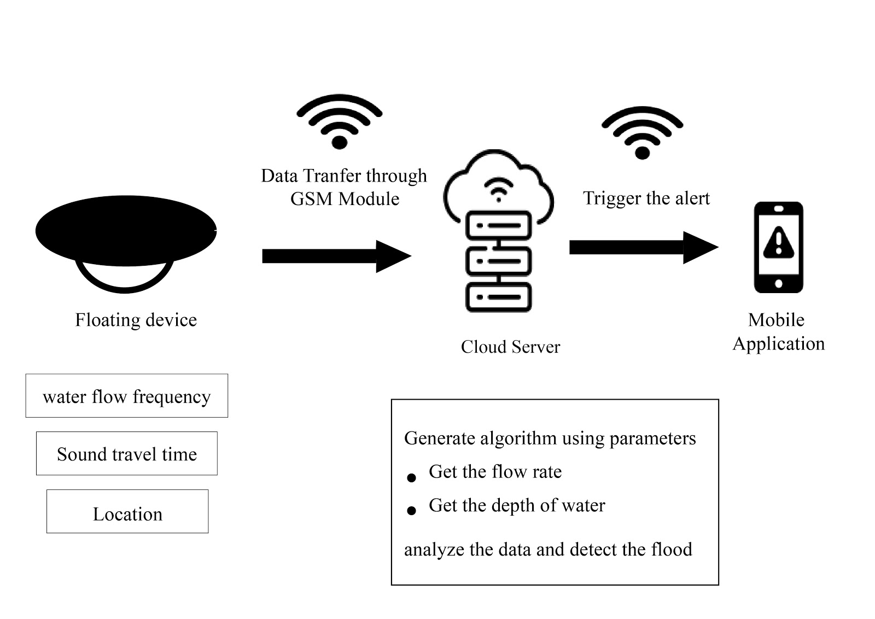
ARCHITECTURE DIAGRAM OF FLOOD PREDICTION
Figure 12 Architecture diagram of flood prediction

Slide 32

4.2 ENHANCE THE SECURITY
Secure and centralized the access logs and data
Use end to end encrypted protocol to secure communication
Use effective password policies

Slide 33
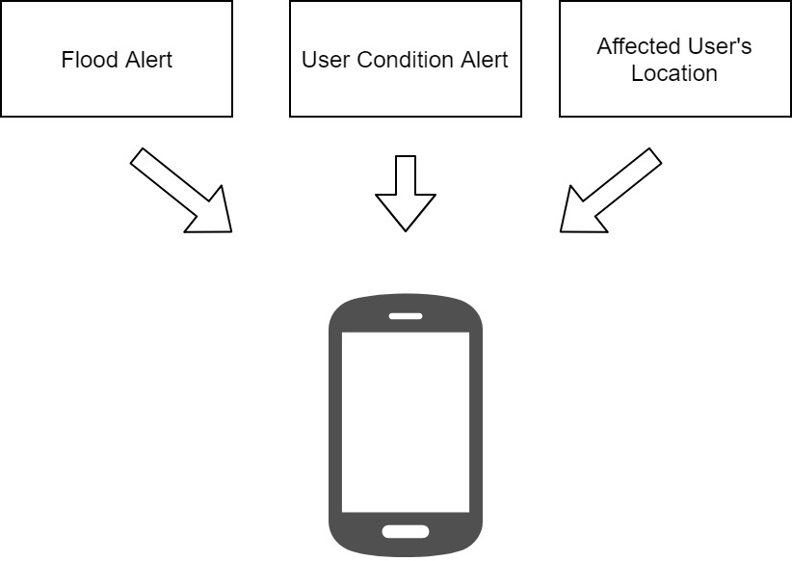

Slide 34
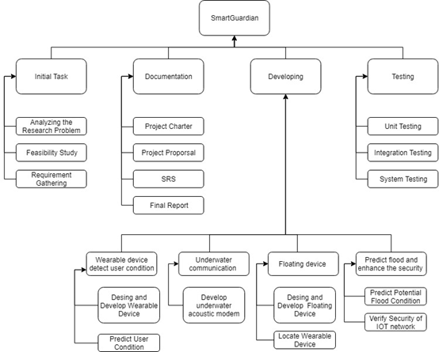
WORK BREAKDOWN STRUCTURE
Figure 13 work breakdown structure

Slide 35
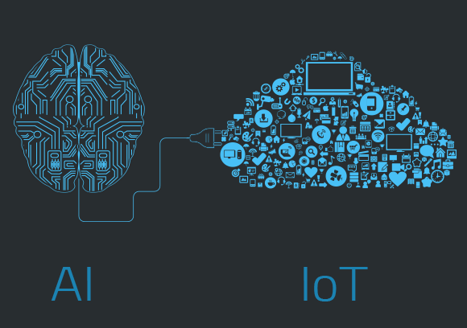
WORKING ON AREAS
Data Communication
Internet of Things
Artificial Intelligence
Machine Learning

Slide 36

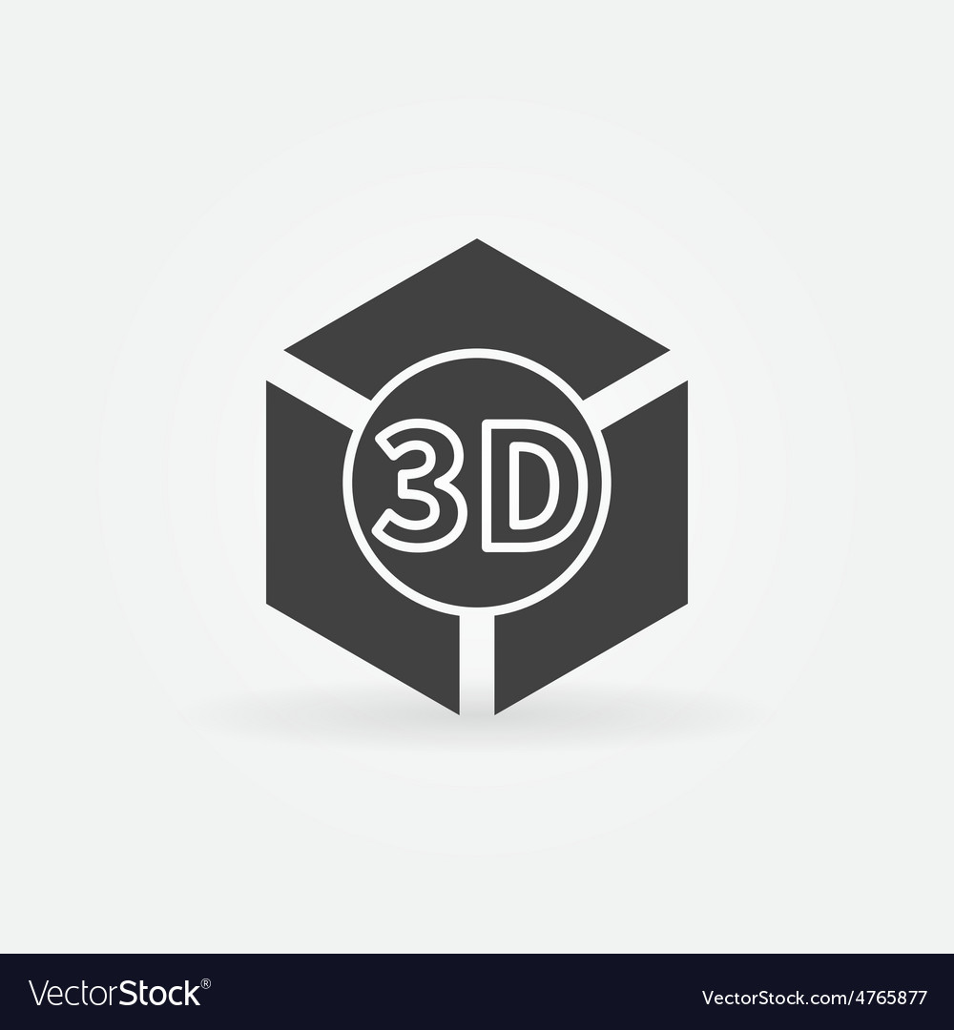

SUPPORT TECHNOLOGIES
Arduino
3D printing
Machine Learning

Slide 37
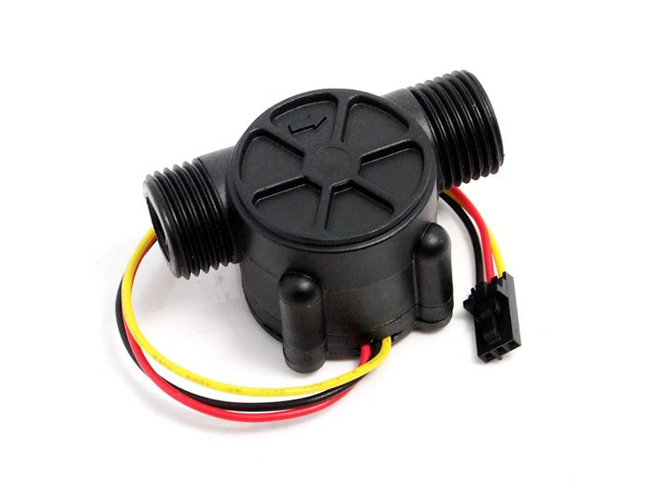
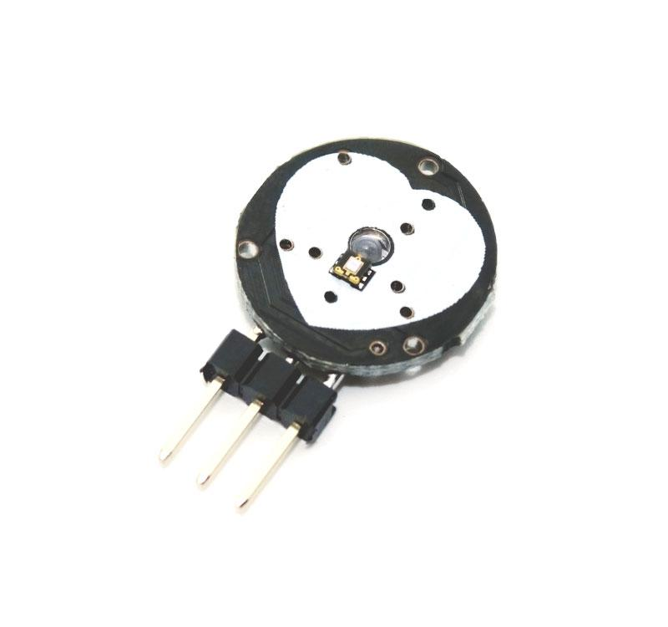
HARDWARE REQUIREMENTS
Arduino UNO Microcontroller
Waterproof Sonar Sensor
Pulse Sensor
Gyro And Accelerometer Sensor
RF Transmitter and Receiver
Water flow Sensor
GPS Module
GSM Module

Slide 38

SOFTWARE REQUIREMENTS
Arduino IDE
AutoCAD
3DS Max
VS Code
GitHub
MongoDB
MS Word
MS PowerPoint

Slide 39
TARGETED AUDIENCE
Lake, River, Seaside hotels
Demand the safety at water of customer.
Travelers
Flood and other water accidents rescue team
Most flooded areas residents

Slide 40
BUDGET
Description | Quantity | Price(Rs)
Arduino UNO Rev3 | 2 | 2,900.00
0.91 Inch LCD Display | 1 | 795.00
Pulse Sensor | 1 | 500.00
Waterproof Sonar Sensor | 3 | 1,950.00
Silicone Sealant | 1 | 1000
GPS Module | 1 | 1900
GSM / GPRS Module | 1 | 2800
MPU6050 - Triple Axis Accelerometer & Gyro Breakout | 1 | 280
Water flow Sensor | 1 | 650
Total |  | 19575

Slide 41
REFERENCE
[1] Emarketer.com, 'Social Networking Reaches Nearly One in Four Around the World', 2014. [Online]. Available: https://www.digital.nyc/startups/iswimband. [Accessed: 24- Feb - 2019].
[2] Anam-dong, Sungbuk-gu, Seoul, Kore, “An Ultrasonic Sensor Based Low-Power Acoustic Modem for Underwater Communication in Underwater Wireless Sensor Networks” , pp. 136-701 , 2007.
[3] Matt Beaumont-Gay,”A Comparison of SYN Flood Detection Algorithms” in International Conference on Internet Monitoring and Protection , August. 2007, DOI: 10.1109/ICIMP.2007.1
[4] Mohammed Khalaf, Abir Jaafar Hussain, Dhiya Al-Jumeily, Paul Fergus, Ibrahim Olatunji Idowu , “Advance Flood Detection and Notification System based on Sensor Technology and Machine Learning Algorithm ” DOI: 10.1109/IWSSIP.2015.7314188 , September 2015.
[5] Opentextbc.ca, 'Speed of Sound, Frequency, and Wavelength'. [Online]. Available: https://opentextbc.ca/physicstestbook2/chapter/speed-of-sound-frequency-and-wavelength/. [Accessed: 8- March- 2019].

Slide 42
THANK YOU !!!

